Slide 1

Strict Transport Security Implementation on http/https conversion
Ahmet Gürbüz
Murat Gün

Slide 2

Agenda
What is http (Hypertext Transfer Protocol) ?
What is HttpS (Secure Http)
What is ssl/tsl?
What is HSTS?
Some Google Improvments for web
Attack Types
Demos

Slide 3
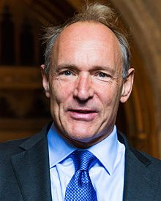
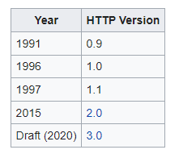


What is http (Hypertext Transfer Protocol) ?
The protocol that is used for viewing web pages.
In its simplest form, it is a bridge that provides data flow between the server and our browser.
In standard HTTP , all information is sent in clear text.
Vulnerable
can be tracable.
password..
payment#$

Slide 4

What is HttpS (Secure Http) ?
This is a http with a security feature.
Encrypts the data that is being retrieved by HTTP.
Uses encryption protocol to scramble the data that’s being transferred.
=
Http
SSL/TSL
HttpS

Slide 5
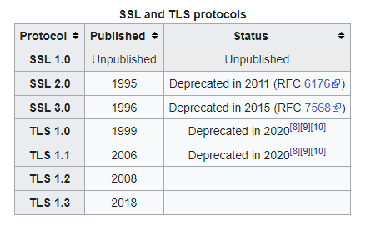




What is Ssl / Tls?
It is an encryption protocol designed to provide secure communication.
An SSl certificate is used to autenticate the identity of webstite.
Web Browser:
Server Identify Yourself
Web Server:
Look At My certificate to prove my ID
Web Browser: Ok I looks good.
I can trust you.

Slide 6

What is HSTS?
It is a mechanism that converts incoming http connections to https.
http://obs.mu.edu.tr
Redirect to https://obs.mu.edu.tr
https://obs.mu.edu.tr
Strict–Transport–Security Header

Slide 7

What is HSTS?
Well, if we were to reach the server in this way in every transaction, wouldn't we be creating unnecessary traffic on the server?
First In-Secure Request
Subsequent In-secure Request
http://obs.mu.edu.tr
http://obs.mu.edu.tr
Redirect to https://obs.mu.edu.tr
Internal Redirect to Secure URL
https://obs.mu.edu.tr
https://obs.mu.edu.tr
Strict–Transport–Security Header

Slide 8
HSTS Header
max-age: the time, in seconds, that browser should remember that site is only to be accesable with https.
inculudeSubDomanins: Optional parameter, this rule applies to all of the site’s subdomains.
Preload: Optional parameter, Activate HTST preload service maintained by Google.

Slide 9
Some Google Decisions
Google's update in July 2018 started to show sites without SSL certificates in low rankings in search engines.
Chrome also now warns users against sites without SSL certificates.
Also released HSTS preload service.

Slide 10


Preload Service
Activates the hsts protocol on the website with preload keyword.
WebSite Owner
https://obs.mu.edu.tr
http://obs.mu.edu.tr
HSTS Preload List
Web Server
Checks obs.mu.edu.tr
in HSTS Preload List
Website User
Strict-Transport-Security: max-age=31556926;inculudeSubDomains;preload

Slide 11
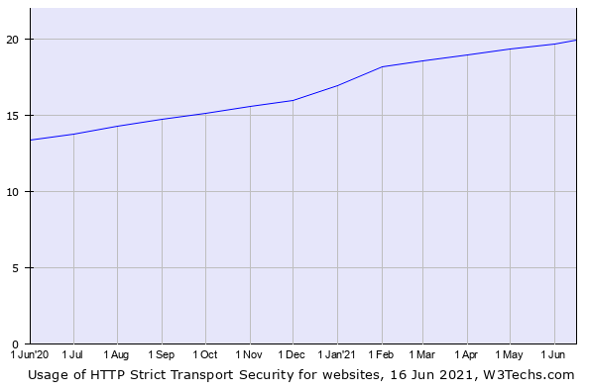
HSTS Usage Popularity
https://w3techs.com/technologies/details/ce-hsts de los Santos, Sergio, et al. "Implementation state of HSTS and HPKP in both browsers and servers." International Conference on Cryptology and Network Security. Springer, Cham, 2016.
Table 1. HSTS usage rates Among 10 million sites

Slide 12


Attack Types
Man In The Middle
Website User
Web Server
HTTP
HTTPS
Attacker

Slide 13
Thank You For Listening…
Next - Demos

